Slide 1

RETAIL
SALES PULSE
From Analysis to Automated Weekly Pipeline
Business Analysis & Weekly Data Pipeline

Slide 2
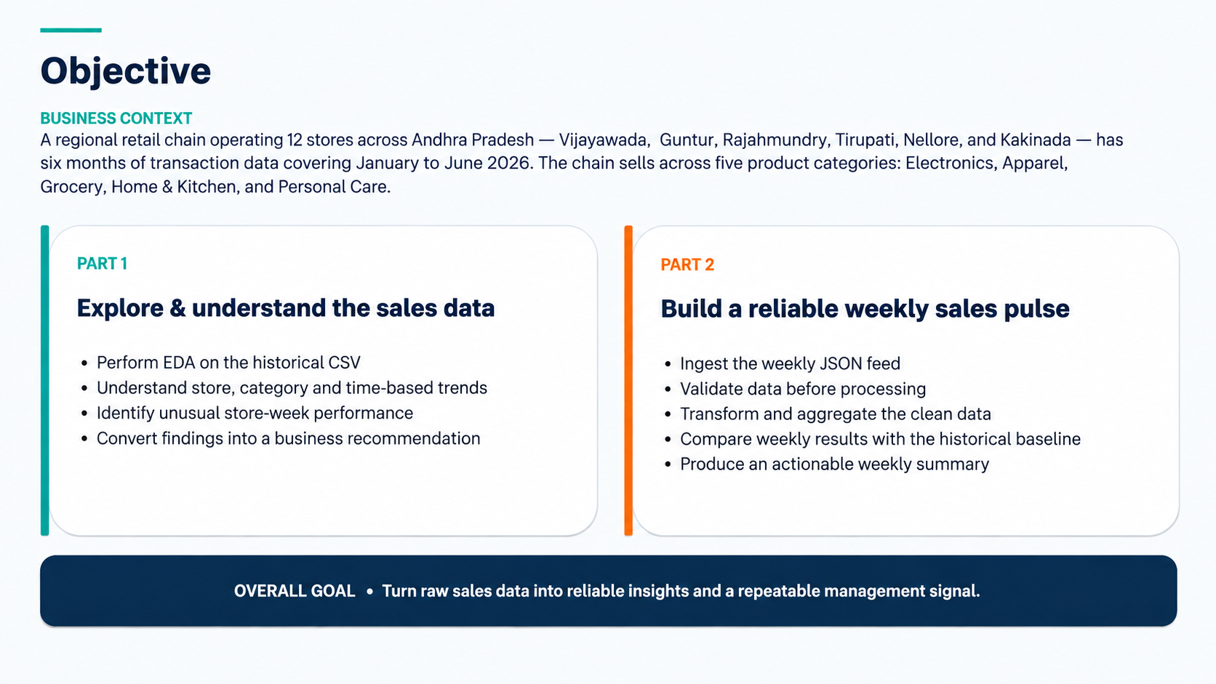

Slide 3
PART 1
5.1 — Load & Inspect the Data
Establish the shape, quality and distribution of the historical dataset
107,836
10
0
₹4,263.92
Transactions
Columns
Null values
Average revenue / transaction
What I did
What the numbers mean
• Loaded the CSV and checked shape, data types and missing values.
• Reviewed descriptive statistics for units sold, price, revenue and discount.
• Compared mean vs median revenue to understand the distribution.
Revenue is right-skewed
Mean revenue is ₹4,263.92, while median revenue is ₹1,034.62 — occasional high-value transactions materially influence the average.
High-value transactions
Maximum transaction revenue is ₹355,090.88. These should be understood by store, category and product before drawing conclusions.
Key takeaway: the historical dataset is complete and suitable for downstream analysis.
Retail Sales Pulse | Phase 1 — Mini Use Case 01
5

Slide 4
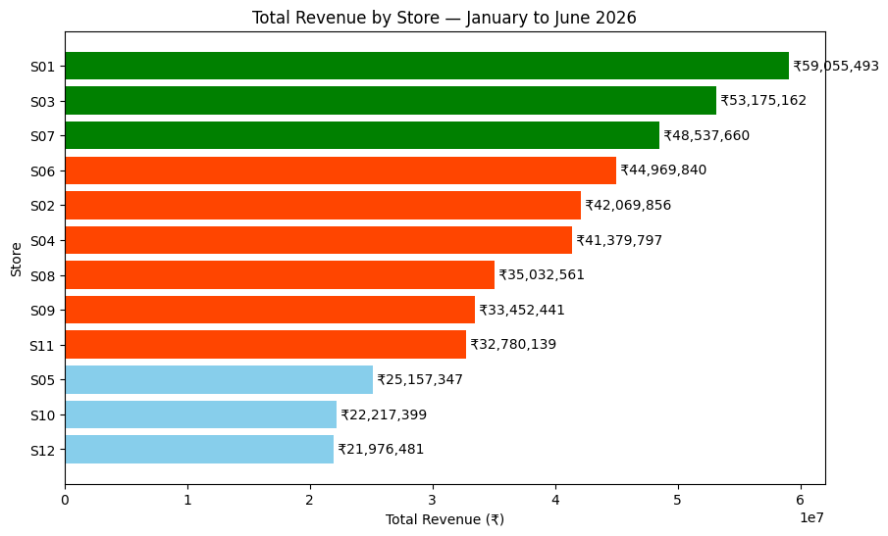
PART 1
5.2 — Revenue by Store
Rank stores by six-month revenue to reveal the performance gap
Top performer
S01 — Vijayawada ₹59.1M
Lowest performer
S12 — Kakinada ₹22.0M
Business interpretation
• There is a significant gap between the strongest and weakest stores.
• Operations should investigate demand, product availability, pricing and local competition.
• The gap can guide where promotional or operational support is most needed.
Retail Sales Pulse | Phase 1 — Mini Use Case 01
6

Slide 5
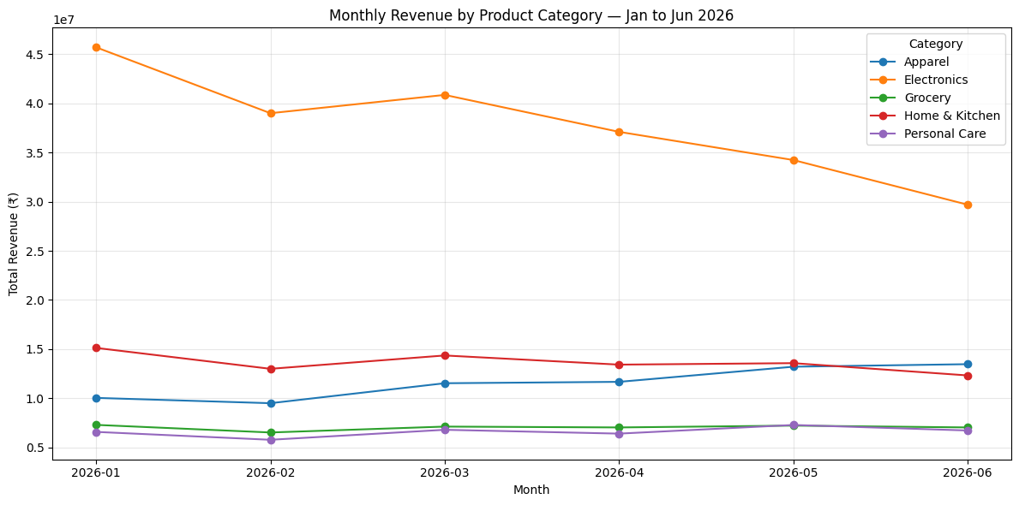
PART 1
5.3 — Category Performance Over Time
Track all five categories from January to June 2026
Steepest decline
Electronics fell 35.02% from January to June, making it the clearest category-level warning signal.
Most stable
Grocery shows the most consistent revenue pattern across the six-month period.
Explanation
• Electronics needs investigation because the decline is large and sustained.
• Grocery provides a relatively stable revenue base and a useful benchmark.
• The next step is to isolate the stores and products driving the Electronics decline.
Retail Sales Pulse | Phase 1 — Mini Use Case 01
7

Slide 6
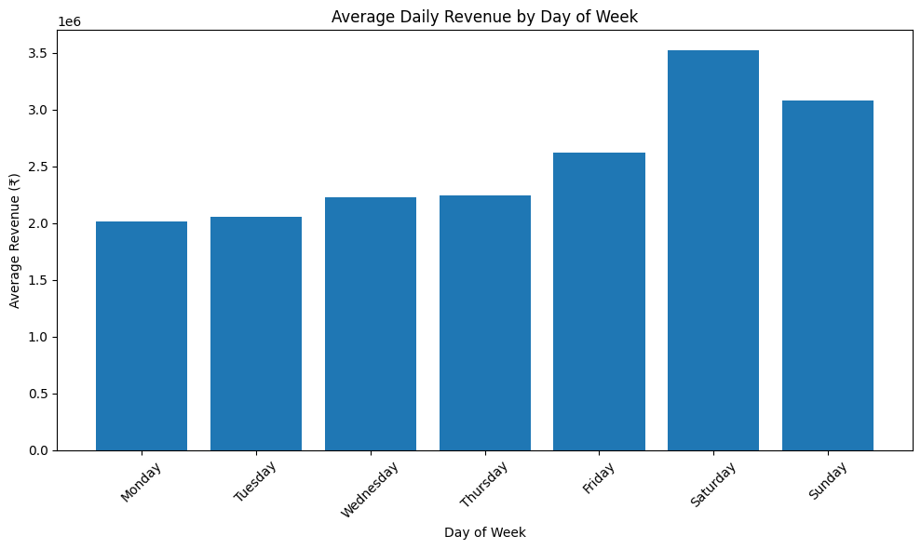
PART 1
5.4 — Day-of-Week Pattern
Use average daily revenue to identify the strongest and weakest trading days
Best day
Saturday ₹35.24 lakh average
Worst day
Monday ₹20.12 lakh average
Promotion implication
• Test a flash promotion on Monday to lift the weakest trading day.
• Use Saturday as a benchmark because demand is already strong.
Retail Sales Pulse | Phase 1 — Mini Use Case 01
8

Slide 7
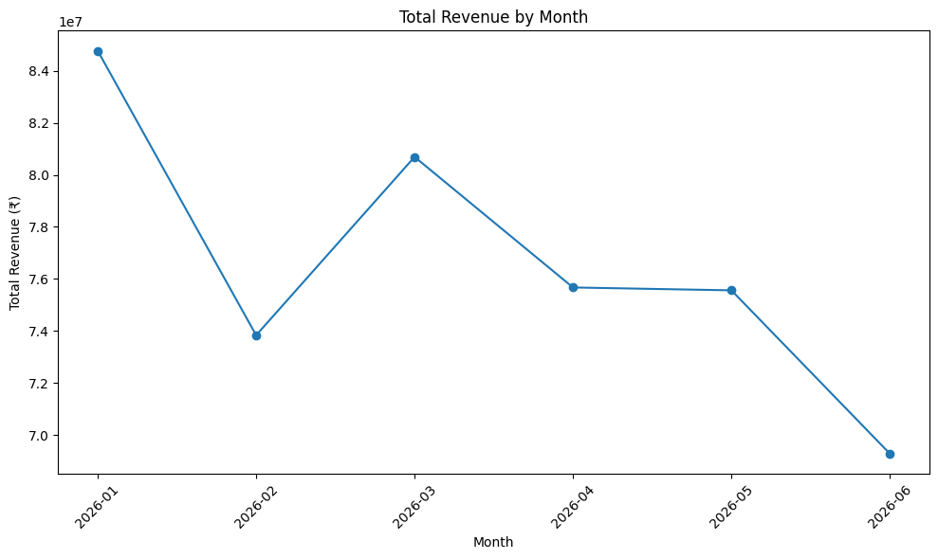
PART 1
5.4 — Monthly Revenue Pattern
Compare total revenue across the six-month period
Strongest month
January ₹84.77M
Weakest month
June ₹69.28M
Business interpretation
• Revenue fluctuates materially across the period.
• The operations team should test whether seasonality or demand changes explain the decline toward June.
Retail Sales Pulse | Phase 1 — Mini Use Case 01
9

Slide 8
PART 1
5.5 — Anomaly Identification
Flag store-weeks below each store's lower threshold
Store | Week | Revenue | Lower threshold
S02 | 2026-05-18 | ₹1,173,289.36 | ₹1,174,000.00
S04 | 2026-06-08 | ₹1,137,480.32 | ₹1,141,545.00
S05 | 2026-02-09 | ₹655,732.19 | ₹723,179.80
S10 | 2026-04-06 | ₹505,536.54 | ₹539,510.50
Lower threshold
Mean − 2 × Standard Deviation
4 anomalies identified
How to interpret
A store-week is anomalous when revenue falls below its own lower threshold. These are warning signals, not confirmed causes.
Notebook interpretation
Possible explanations include supply disruption, local events, pricing issues or competitor activity; further investigation is required.
Retail Sales Pulse | Phase 1 — Mini Use Case 01
10

Slide 9
PART 1
5.6 — Business Recommendation
Turn the EDA findings into one operational decision
MOST IMPORTANT FINDING
S12 (Kakinada) had the lowest six-month revenue, while Electronics declined 35.02% from January to June.
Recommended action
• Investigate S12 before increasing Q3 promotional spend.
• Focus on demand, inventory availability, pricing and local competition.
• Investigate which stores and products are driving the Electronics decline.
Recommendation
Prioritize S12 and the Electronics decline for investigation before committing additional promotional spend.
Retail Sales Pulse | Phase 1 — Mini Use Case 01
11

Slide 10
PART 2
Part 2 Pipeline — From API to Weekly Decision
The engineering goal is repeatability, reliability and a business-ready output
1
→
2
→
3
→
4
→
5
INGEST
PARSE
VALIDATE
TRANSFORM
SUMMARIZE
Receive weekly JSON
Extract transaction records
Stop on data-quality issues
Aggregate + compare baseline
Produce Monday report
Clean path
Failure path
Clean API → validated records → weekly metrics → business summary.
Corrupt API → validation failure → pipeline halted → investigate and correct data.
This connects Part 1 and Part 2: the historical analysis becomes the baseline for the weekly alert.
Retail Sales Pulse | Phase 1 — Mini Use Case 01
13

Slide 11
PART 2
5.7 — Understand the JSON Structure
Know the payload before extracting data
Top-level JSON object
Where is the transaction data?
Inside the data key → a list of transaction records.
status
period
request_id
record_count
Why this structure works
• Metadata describes the response and reporting period.
• record_count provides a completeness check.
• data carries the actual weekly transactions.
• A downstream system can validate metadata, extract records and continue processing.
generated_at
data
Result
The payload is structured like a real retail API response: metadata + transaction data.
Retail Sales Pulse | Phase 1 — Mini Use Case 01
14

Slide 12
PART 2
5.8 — Ingest & Parse the API Response
Convert the weekly JSON payload into an analysis-ready DataFrame
4,291
4,291
MATCH
7 days
Records in JSON
Records in DataFrame
Record-count check
Jun 24–30, 2026
What I did
Why the count check matters
• Extracted transaction records from the data key.
• Loaded them into a Pandas DataFrame.
• Converted the date field to datetime.
• Confirmed actual records equal the API metadata record_count.
• Confirmed the reporting period from the metadata.
Completeness control
If the API says 4,291 records but fewer arrive, the downstream report could be incomplete. The pipeline should detect this before processing.
Outcome
Weekly data is ready for validation and aggregation.
Retail Sales Pulse | Phase 1 — Mini Use Case 01
15

Slide 13
PART 2
5.9 — Validate the Data Before Processing
How the validation function checks the corrupt API payload
HOW I DID IT
Validation Summary
Step 1 — Load
Loaded the corrupt JSON response and converted its transaction data into a DataFrame.
----------------
Total records checked: 4291
Null values found: 1 (row 12, column: units_sold)
Step 2 — Check rules
Checked null values, revenue ≤ 0, and store IDs outside the valid S01–S12 list.
Negative revenue found: 1 (row 5, revenue: -150.0)
Invalid store IDs found: 1 (row 20, store_id: S99)
Step 3 — Stop on failure
Collected all issues and returned a failed status rather than processing corrupt data.
Status: FAILED — 3 issues detected. Pipeline halted.
This makes the pipeline fail-fast and prevents unreliable downstream results.
Retail Sales Pulse | Phase 1 — Mini Use Case 01
13

Slide 14
PART 2
5.10 — Transform & Aggregate
Turn clean weekly records into decision-ready metrics
S03
₹2.04M
Electronics
−34.2%
Top store this week
S03 weekly revenue
Category alert
Vs 6-month baseline
Required outputs
• Total revenue per store for the 7-day period.
• Total revenue per category for the 7-day period.
• Single highest-revenue store.
• Category alert where weekly revenue is >20% below the 6-month daily baseline.
Weekly category result
Electronics
₹5.76M
−34.2%
Apparel
₹3.23M
No alert
Home & Kitchen
₹2.85M
No alert
Grocery
₹1.62M
No alert
Personal Care
₹1.56M
No alert
The historical CSV is what makes the weekly alert meaningful: current performance is judged against a baseline.
Retail Sales Pulse | Phase 1 — Mini Use Case 01
17

Slide 15
PART 2
5.11 — Pipeline Summary Output
How the clean weekly JSON becomes the final management summary
HOW I DID IT
=== RETAIL SALES PULSE — WEEKLY SUMMARY ===
Step 1 — Load & parse
Loaded the clean JSON with json.load(), extracted data into a DataFrame and converted date to datetime.
Period: 2026-06-24 to 2026-06-30
Records processed: 4291
Step 2 — Aggregate
Top store this week: S03 — Guntur (₹2,037,560.19)
Grouped revenue by store and category, then identified the highest- and lowest-revenue stores.
Bottom store this week: S10 — Nellore (₹627,119.87)
Category alert: Electronics revenue down 34.2% vs 6-month baseline
Step 3 — Compare baseline
No alert: Apparel, Grocery, Home & Kitchen, Personal Care
Used the 6-month CSV baseline to calculate the category alert and generated the report dynamically.
Pipeline status: COMPLETED SUCCESSFULLY
Retail Sales Pulse | Phase 1 — Mini Use Case 01
15

Slide 16
CONCLUSION
Conclusion
What the complete use case proves
The analysis and pipeline work together as one decision system.
Part 1 shows where performance needs attention. Part 2 makes that insight repeatable every week.
1. Identify
2. Protect
3. Repeat
S12 is the lowest six-month store and Electronics shows the steepest category decline.
The validation gate catches all 3 intentional API data-quality issues before processing.
The clean weekly pipeline produces a structured sales pulse with an actionable alert.
Final recommendation
Investigate S12 and the Electronics decline first, then use the weekly pipeline to track whether performance improves.

Slide 17
THANK YOU
Questions & Discussion

